Slide 1
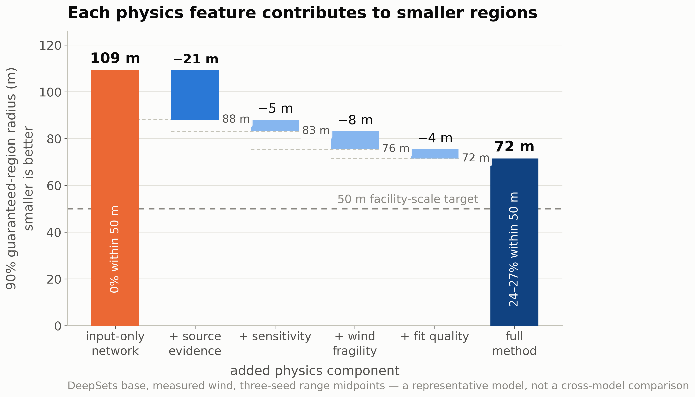
DeepSets component ablation: the source-evidence map provides the largest single reduction in region radius (−21 m), and each added physics component contributes further — the maps carry complementary information.

